Slide 1
Careers in Finance
9/12/2011

Slide 2
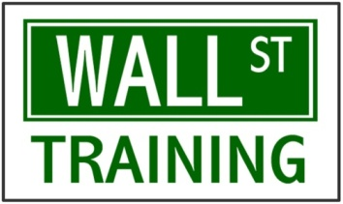
INVESTMENT BANKING &
CAREER DEVELOPMENT
… exclusive modeling &
valuation weekend training seminar!
www.wallst-training.com
LEARN THE TECHNICALS
CAREER DEVELOPMENT = SUPER-STAR
Core Model: 5-year integrated financial statement projection model
Valuation: Major valuation methodologies (comps, DCF, reference range, football field)
Corporate Finance fundamentals, capital structure, leverage, Enterprise Value, etc.
Same material we use to train banks, research firms, private equity & hedge funds
Destroy your competition by receiving internship/job Q&A’s before the interview!
We’ll tell you how to stay competitive in 2011 and finish as the #1 intern/analyst!
Essential for business majors and as a supplement for ANY liberal arts degree!
Possible inclusion to our exclusive, invitation-only WST Banker’s Club (wstbankersclub.com)
WANT TO BOOST YOUR CAREER?
WHAT, WHEN AND WHERE?!
Goldman Sachs, Morgan Stanley, JP Morgan, BofA/Merrill Lynch: we have contacts all over!
Taught by senior industry professionals active on Wall Street to provide you the most up-to-date market information!
Show us your enthusiasm and we’ll keep an eye on you!
What: Financial Modeling & Valuation Seminar
When: October 8-9, 2011;
9AM-5PM Saturday, 9AM-3PM Sunday
Price: Professionals: $1,500, Student: $175
Paid MSUFA Members in “good standing” $150 90 % off regular price!!!
Link: www.wallst-training.com/msu
Contact: tyler@wallst-training.com

Slide 3
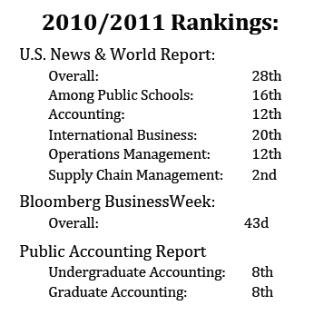
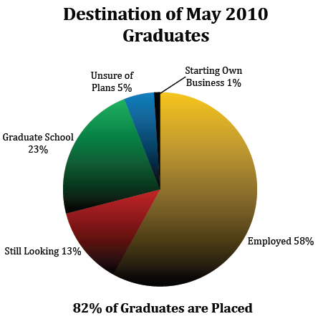
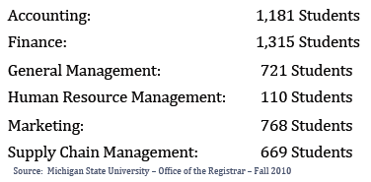
Eli Broad College of Business Overview
Notes:
2010/2011
Rankings:
U.S.
News
&
World
Report:
Overall:
28th
Among
Public
Schools:
16th
Accounting:
12th
International
Business:
20th
Operations
Management:
12th
Supply
Chain
Management:
2nd
Bloomberg
BusinessWeek:
Overall:
43d
Public
Accounting
Report
Undergraduate
Accounting:
8th
Graduate
Accounting:
8th

Slide 4
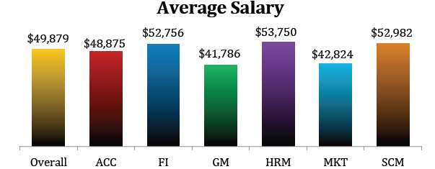
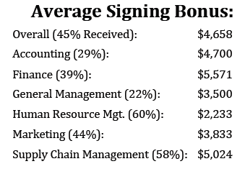
Eli Broad College of Business Overview
Notes:
2010/2011
Rankings:
U.S.
News
&
World
Report:
Overall:
28th
Among
Public
Schools:
16th
Accounting:
12th
International
Business:
20th
Operations
Management:
12th
Supply
Chain
Management:
2nd
Bloomberg
BusinessWeek:
Overall:
43d
Public
Accounting
Report
Undergraduate
Accounting:
8th
Graduate
Accounting:
8th

Slide 5
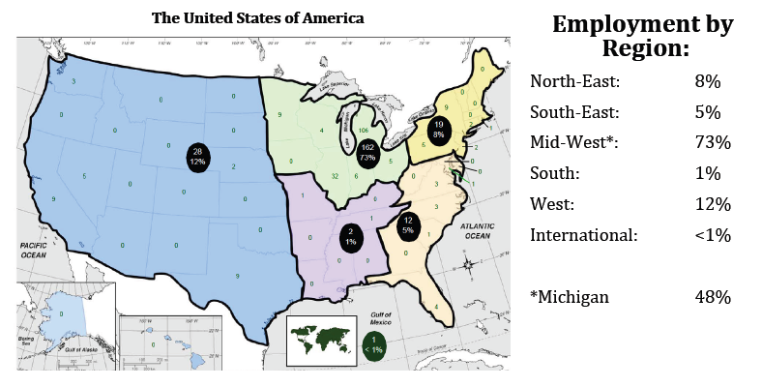
Eli Broad College of Business Overview
Notes:
2010/2011
Rankings:
U.S.
News
&
World
Report:
Overall:
28th
Among
Public
Schools:
16th
Accounting:
12th
International
Business:
20th
Operations
Management:
12th
Supply
Chain
Management:
2nd
Bloomberg
BusinessWeek:
Overall:
43d
Public
Accounting
Report
Undergraduate
Accounting:
8th
Graduate
Accounting:
8th

Slide 6
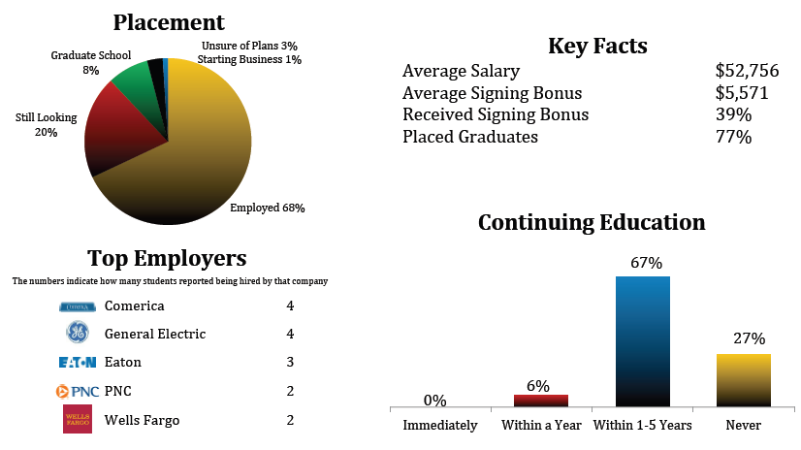
Eli Broad FINANCE Overview
Notes:
Minimum Salary 30k, Maximum Salary 120k
Other Employers Include:
Bank of America Merrill Lynch
Bloomberg
Chase
Citigroup
Eaton Corporation
General Electric
Kellogg
New York Life
Plante Moran, Plante Moran Financial Advisors
Wells Fargo

Slide 7
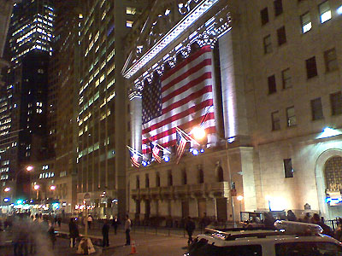
Traditional Careers in Finance
Corporate Finance
Wealth Management
Consulting
Equity Research
Sales and Trading
Investment Banking
Second Step Careers: Hedge Funds, Venture Capital, Private Equity
Capital Markets?

Slide 8
Corporate Finance
In a nut shell…
Create value for the stockholders, ensure business runs smoothly
Ideal Candidates
Undergrads with the ability to avoid crisis and generate solutions
Average Starting Salary:
$35-50 K
Average Hours:
40 +
Exit Opportunities:
Easier to advance within large company, possibility to join Accounting Firm
Respected Companies:
Ford, GM, GE, General Mills, Dow Corning

Slide 9
Board of Directors
Chairman of the Board and CEO
President and Chief Operations Officer (COO)
Vice President and Chief Financial Officer (CFO)
Treasurer
Controller
Tax Manager
Cash Manager
Credit Manager
Capital Expenditures
Financial Planning
Financial Accounting Manager
Cost Accounting Manager
Data Processing Manager

Slide 10
Corporate Finance
Pro’s:
Opportunity to travel, ability to advance quickly while working in large corporation, reasonable hours
Con’s:
Not a “glamour” job until senior leadership is reached, analyzing performance while often times you don’t see the products on a day-to-day basis, pay is not as lucrative as I-Banking, PE, etc.
Most Relevant Courses at MSU:
Any ACC course, FI 311, FI 312, FI 414, FI 451, FI 455, ITM 309
Other ideas:
Corporate Finance Case Study
CPA

Slide 11
Typical Day in Corporate Finance
6am: Sleep
7am: Sleep
8am: Arrive at work, check email, make sure of no emergencies
9am: Analyze the financial health of competing companies
10am: Review company results, what is the cause of performance
11am: Call divisions within company who see operations firsthand
12pm: Perform trend analysis, are things going as planned?
1pm: Consolidate divisional data, put together report due at end of WD
2pm: Attend team meeting
3pm: Prep for earnings call, anticipate questions from investors
4pm: Work on budget cycle extending out as far as 5 years
5pm: Meet with senior leadership to discuss consolidated reports

Slide 12
Wealth Management
In a nut shell…
Make rich people richer
Ideal Candidates
Undergraduates with both quantitative and personal skills
Average Starting Salary:
50-60k, signing bonus and performance compensation
Average Hours:
50-80 hours, varies significantly by firm and office culture
Exit Opportunities:
Some opportunities exist to join VC, PE, and HF in client relations and fundraising
Respected Companies:
J.P. Morgan, Goldman Sachs, Bessemer Trust, Plante Moran, Credit Suisse, UBS

Slide 13
Wealth Management
Pro’s:
Work with people (not institutions), trusted advisor to some of the most recognized families in America, challenge is knowing a thousand things six hundred feet deep (not one thing a thousand feet deep or one thing a thousand feet deep!)
Con’s:
People are demanding!, some roles can be very administrative “back office”, less of a pipeline to VC, HF, PE than investment banking
Most Relevant Courses at MSU:
FI 311, FI 312, FI 457, EC 330, MGT 475, COM 325, COM 360, and PSY Classes
Other ideas:
Financial Markets Institute (FMI)
Sales Communication Specialization

Slide 14
Typical Day in Wealth Management
6am: Firm wide daily market call (be sure to have slides prepared!)
7am: Return to desk, make sure you are up on the markets
8am: Make final changes on investment performance book for client
9am: Monitor markets for liquidity events and catalysts
10am: Grab Starbucks just to have an excuse to get away from the desk
11am: Call structures desk to ensure understanding of client position
12pm: Banker get’s back book with edits, needs final copies by 3pm
1pm: Drop everything to make necessary changes for prospect book
2pm: Beg printing team to give preference to your books! Last edits!
3pm: Listen to firm wide call on QE2 while creating prospect profiles
4pm: Attend team meeting
5pm: Send email to banking team explaining client’s structured product
6pm-9pm: Much of the same!

Slide 15
Consulting
In a nut shell…
Work on solving businesses most integrate and complex problems
Ideal Candidates
Undergraduates with creativity, and ability to solve complex and integrate problems
Average Starting Salary:
60-70k, signing bonus and performance compensation
Average Hours:
75-80 hours
Exit Opportunities:
Top MBA programs, VC, PE, senior and executive level positions in small and large businesses
Respected Companies:
McKinsey, Bain, Boston Consulting Group, A.T. Kearney,

Slide 16
Consulting
Pro’s:
Steepest learning curves, varying experiences, travel
Con’s:
Travel, selective (GPA, ACT, SAT matters a whole lot!), work can lack action and results
Most Relevant Courses at MSU:
MGT 352, MGT 409, MGT 872, MGT 875, MGT 878
Other ideas:
Students Consulting for Non–Profit Organizations (SCNO)
Start practicing consulting case studies

Slide 17
Typical Day in Consulting
6am: Email research team asking them to clarify their data
7am: Update slides for MD
8am: Sit down with team to discuss thoughts on project
9am: Interview senior management discussing concerns and input
10am: Call Partner to discuss progress and look for insight
11am: Organize research team’s data to offer information on P’s idea
12pm: Read research on industry
1pm: Read research in industry
2pm: Discuss with team industry research implications on project
3pm: Prepare for CFO interview with team
4pm: Email research team for more analysis
5pm: Interview CFO
6pm: Debrief with team new directions on case

Slide 18
Equity Research
In a nut shell…
Develop and communicate insights regarding covered securities
Ideal Candidates
Undergraduates who enjoy reading, writing, and are passionate about the markets
Average Starting Salary:
60-70k, signing bonus and performance compensation
Average Hours:
75-80 hours
Exit Opportunities:
Hedge Funds, Research Analyst at PE/VC Firms, Senior and Executive level positions in small and large businesses
Respected Companies:
Goldman Sachs, Morgan Stanley, JP Morgan

Slide 19
Equity Research
Pro’s:
Learn vast amount of information about sectors/companies that you cover, Allows you to express your individual thoughts about companies through your reports
Con’s:
Clients and traders may loose interest in your opinion after one bad call, The most writing of any career on Wall Street (Reports can be 200+ pages)
Most Relevant Courses at MSU:
FI 311, FI 312, FI 414, FI 457, FI 857
Other ideas:
Financial Markets Institute (FMI)
Student Investment Association (SIA)
Begin doing research own research and excel modeling

Slide 20
Typical Day in Equity Research
6am: Wrap up morning update and send out firm wide
7am: Update models as new data is released
8am: Answer questions on morning update and model updates
9am: Prepare for market open and phone calls with traders / clients
10am: Work on finishing sector and company updates
11am: Send sector and company updates to MD
12pm: Take more calls from traders / clients
1pm: Proof read new reports before they are distributed
2pm: Call sector insiders to discuss updates in the sector
3pm: Receive MD changes to sector/company reports, make changes
4pm: Dial into company earnings call
5pm: Update research/models with new details from earnings call
6pm: Begin preparing data for tomorrows morning update

Slide 21
Sales and Trading
In a nut shell…
Buy and sell financial instruments in the market
Ideal Candidates
Undergraduates who enjoy real time feed back on their work, constant communication, and are passionate about the markets
Average Starting Salary:
70-100k, signing bonus and performance compensation
Average Hours:
50-75 hours
Exit Opportunities:
Hedge Funds, Proprietary Trading Firms, MBA Programs
Respected Companies:
Goldman Sachs, Deutsche Bank, Citi, JP Morgan

Slide 22
Sales and Trading
Pro’s:
Opportunity to make more money than in most other careers, less hours than most other Wall Street jobs, something new is always happening
Con’s:
If you blow up you probably won’t get another job in S&T, if markets are very volatile (like right now) you have a lot of sleepless nights, fewer attractive exit opportunities
Most Relevant Courses at MSU:
FI 473, FI 455, FI 452, FI 457, FI 857, FI 852
Other ideas:
Financial Markets Institute (FMI)
Student Investment Association (SIA)
Begin trading in your own brokerage account

Slide 23
Typical Day in Sales and Trading
6am: Log into Bloomberg Terminal, See what happened overnight
7am: Read Morning updates and call research teams to ask questions
8am: Dial into morning call, Start trading pre market
9am: Prepare for market open, start getting/submitting a lot of orders
10am: Call clients and tell them what you are seeing in the markets
11am: Put on hedges for positions that are being traded quickly
12pm: Speak with clients/research team about market outlook
1pm: Dial into mid day calls
2pm: Ensure that the morning orders have gone through correctly
3pm: Begin closing out day trade/non overnight positions
4pm: Run P/L, See how entire group/bank did for the day
5pm: Update/build models that group may need
6pm: See how global markets are trading before going home

Slide 24
Investment Banking
In a nut shell…
Raise capital for corporate clients
Ideal Candidates
Strong analytical and verbal skills, attention to detail
Average Starting Salary:
65-85k +Bonus
Average Hours:
75-100
Exit Opportunities:
Anything! PE, HF, Corporate Development at Fortune 500 company or back to school at a top tier business school
Respected Companies:
Goldman Sachs, Citi, Bank of America, Deutshe Bank, Credit Suisse

Slide 25
Investment Banking
Pro’s:
Very steep learning curve, work with really smart people, training, opens a lot of doors for exit opportunities
Con’s:
Work/Life Balance – very long hours, very selective, work with all types of personalities
Most Relevant Courses at MSU:
FI 311 – Building block
FI 414 – Case studies and modeling skills
FI 455 – Excel skills
ACC 201, 300, 301, 305 – Lots of Accounting is good to have for IB
Other ideas:
Take on any leadership role and sell it in the interview

Slide 26
Typical Day in Investment Banking
6am: Snooze a couple more hours while your friends in S&T are heading to work
9am: Arrive to the office, check email
10am: Work on valuation model
11am: Finish up pitch book for the presentation later today
1pm: Conference call with deal team to discuss the deal
3pm: Get back to the cube and work more in Excel on transaction comparables

Slide 27
Typical Day in Investment Banking
5pm: Gather information from industry reports and put together a working group list for the deal
6pm: Throw together public information books and work on the discounted cash flow model (DCF)
9pm: Critique pitch book before it is sent to the Managing Director
11pm: Go home at this time on a good night
1am: Could be heading home at this time on some nights

Slide 28
Actuarial
3rd best job in America for 2011 – CNBC
Named best job in 2010 – Wall St. Journal
1 of the 10 jobs that pay $80,000/year – CNN
Top paying jobs – Yahoo Finance
………..

Slide 29
Actuarial
Determine how much an insurance company should charge for auto insurance, for homeowners insurance, as well as for business, taking into account many factors. (Property)
Develop life insurance products so that children will be cared for in the event of an accident? (Life Annuity)
Help companies establish their retirement plans. (Retirement Benefit)
Assist banks and other financial institutions in managing their assets and liabilities and develop ways to manage financial risk. (Finance)

Slide 30
Actuarial
In a nut shell…
Actuary evaluate the likelihood of future events and manage risk
Ideal Candidates
Specialized math knowledge: Calculus, statistics, probability;
Keen analytical, project management, and problem solving skills;
Good business sense - Finance, Accounting, Economics;
Solid communication skills;
Strong computer skills (Excel, SAS, other programming languages, etc);
Average Starting Salary: $56,320 (potential $150,000 to $250,000 )
Average Hours: at least 40 hours
Respected Companies: Deloitte Consulting LLPA, Nationwide Insurance, MetLife Insurance, Fidelity, etc

Slide 31
Actuarial
Actuarial Exams: 5 preliminary SOA exams, VEE credits in Economics, corporate Finance, and applied statistics –ASA (80 – 165)
Pass other 5 exams in selected track – FSA (100 – 500+)
Pro’s: Higher Salary with better balance between work and life. Less physical demands, more job security among top paying jobs.
Con’s: hard to be qualified to work in this field, keep taking exams throughout your life (6-10 years and even more)
Most Relevant Courses at MSU: FI311, FI321, FI379(MFE), MTH360(FM), STT441(P), STT455(MLC), EC, ACC
Other ideas: Visit www.soa.org & www.beanactuary.org
Talk to Prof. Cohen, Albert acohen@msu.edu
Specialization in Actuarial Science

